Slide 1
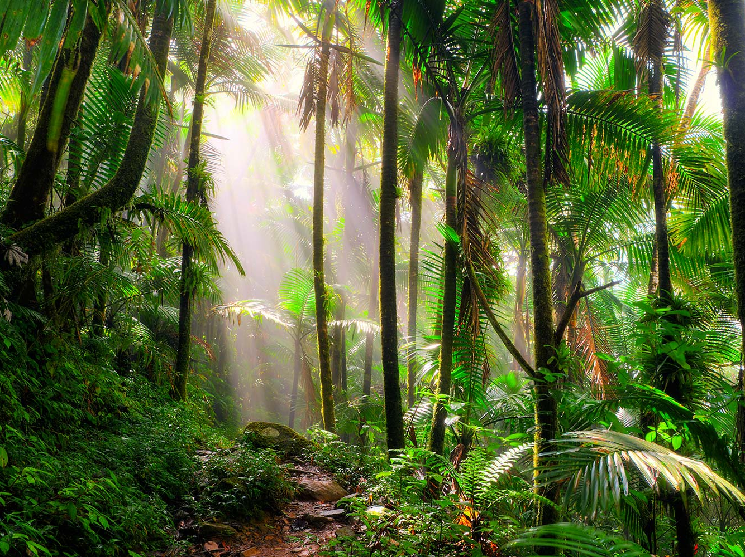
ATAR GEOGRAPHY 3.1
Kimberly Wade-Wear #19956736

Slide 2
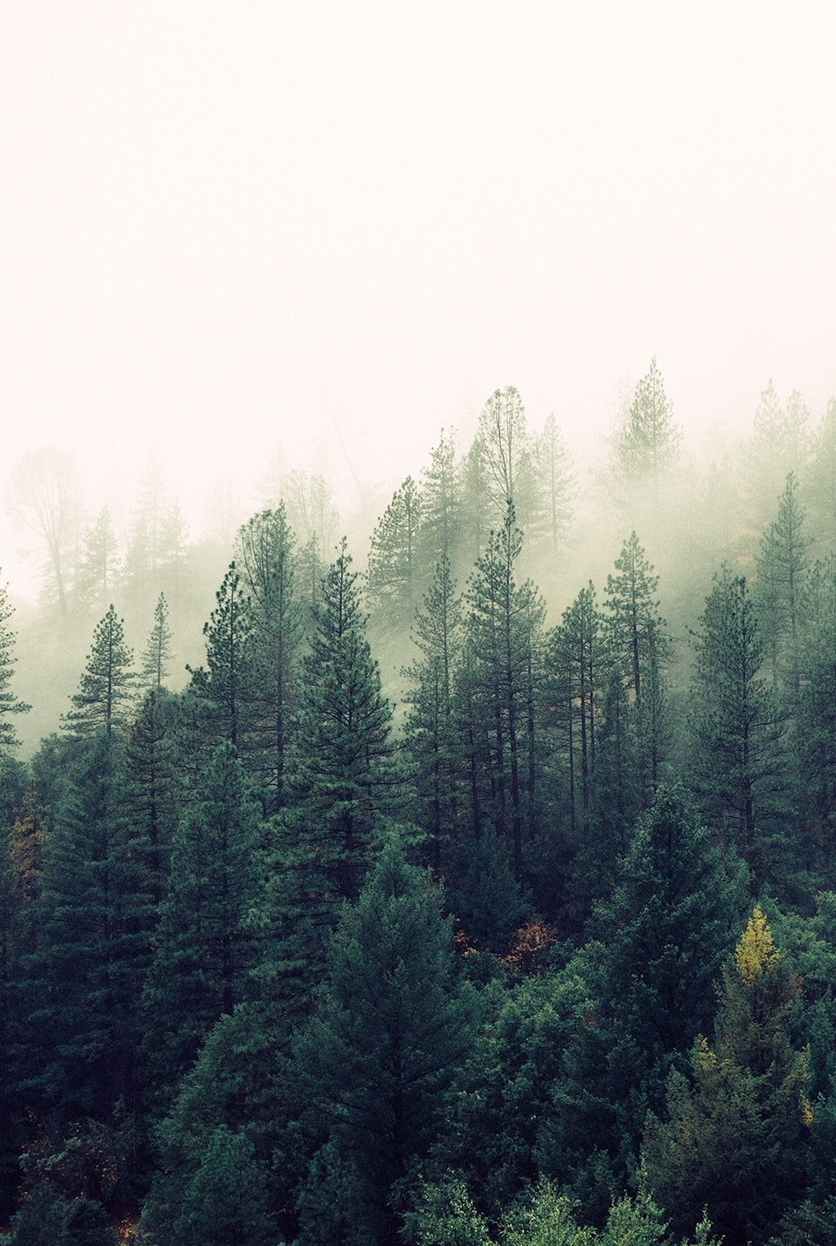
Syllabus Point
The concepts of environment, natural and anthropogenic biomes, land cover change, ecosystem structure and dynamics, biodiversity loss, climate change and sustainability.

Slide 3

The concept of environment
Environment: Is defined as the living and non-living elements of the earth’s surface and atmosphere. It includes human changes to the earth’s surface such as croplands, planted forests, buildings and roads.
From a biological standpoint there are three main types of environments; uninhabitable, uninhabited habitat and inhabited habitat.
Student Activity: Define Environment (2 Marks) with reference to examples.

Slide 4
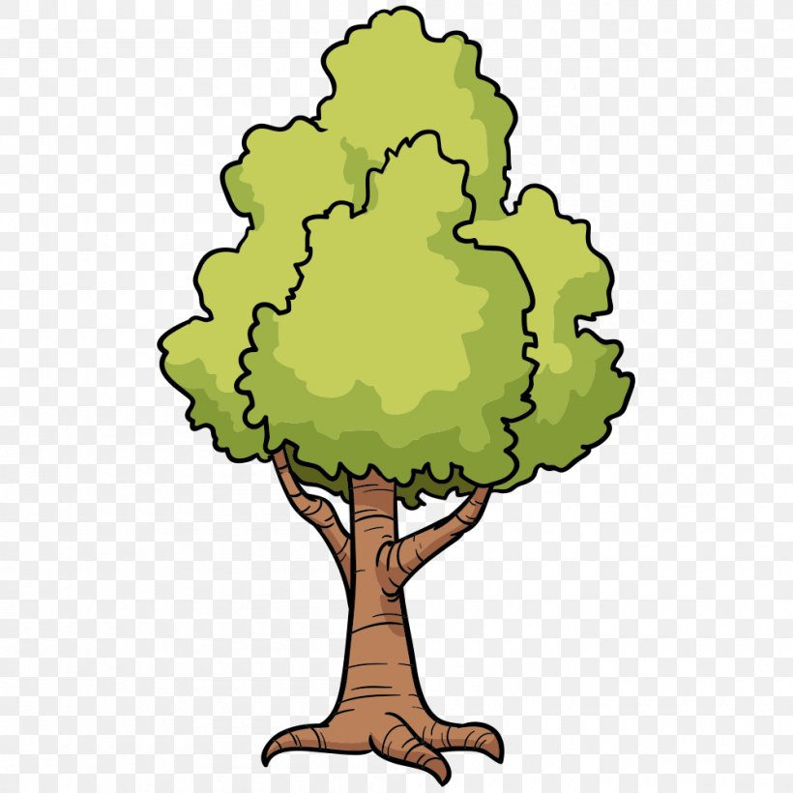
The concept of natural and anthropogenic biomes
Natural Biome: A geographical area of distinct flora and fauna, which have adapted to that environment.
They occur in broad belts across continents, their boundaries correspond to lines of latitude.
Biomes are distinct ecosystems that have formed in response to a shared physical climate.
They are most commonly identified by the dominant vegetation type.
The main types of biomes include; Rainforest, Temperate Forest, Taiga Forest, Tundra, Desert, Savanna, Grassland and aquatic.

Slide 5
The concept of natural and anthropogenic biomes
Anthropogenic Biome: An anthropogenic biome refers to part of the earth’s surface that has been altered through sustained direct interactions between humans and ecosystems.
They are formed through global patterns in human populations and their long term use of the land that has produced land cover change (e.g. rice villages and residential irrigated crop lands).
Approximately only 22% of earth’s ice-free land surface is not affected by human activity.
High populations in associated focused areas have resulted in the development of permanent towns, cities and metropolises across the globe (e.g. Manjimup, Prague, Shanghai)

Slide 6
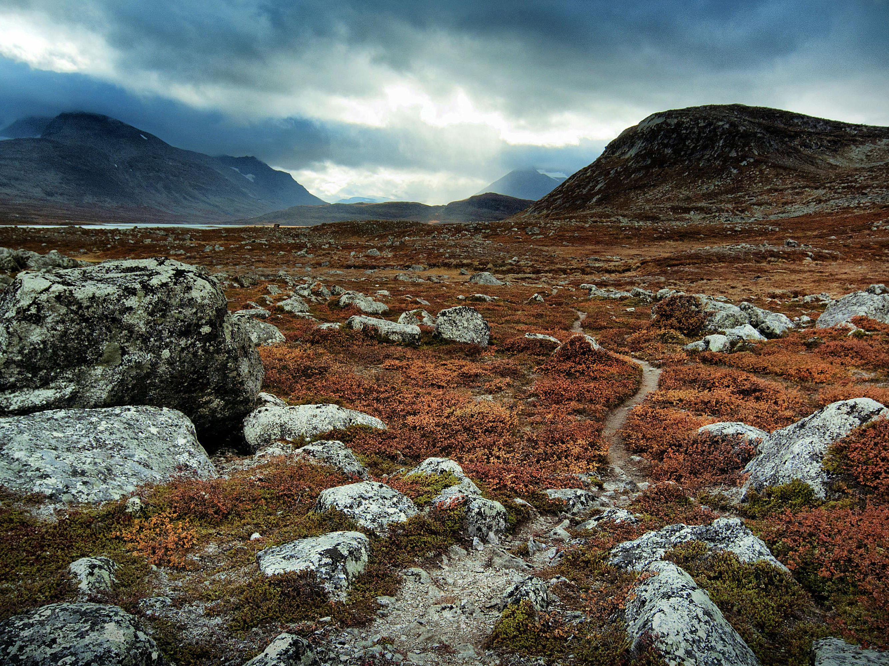
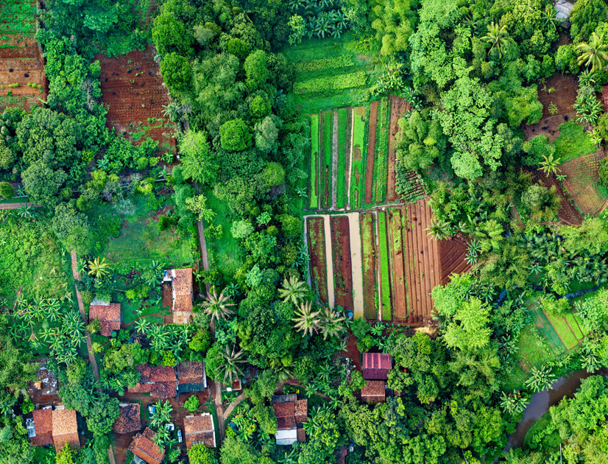
The concept of natural and anthropogenic biomes
Student Activity: With reference to specific examples describe the differences between natural and anthropogenic biomes. (3 Marks)
Define Natural Biome. (2 Marks)
Define the term ‘Anthropogenic Biome’. (2 Marks)

Slide 7

The concept of land cover change
Land Change: Refers to the process in which the earth’s Coverphysical surface is altered due to natural and/or anthropogenic means.
On a natural scale this this can result from changes in climatic conditions over time, natural hazards and changes to river hydrology.
On an anthropogenic scale this can include modification of the land for agriculture, growth of urbanisation, deforestation for a variety of reasons (e.g agriculture) and the rehabilitation of the environment.
South Asia has lost 85% of its rainforests to agricultural purposes. Central America has lost 40% of all its rainforests in the last 40 years in countries like Honduras and Panama with estimates that 2/3rds of this land has been changed to pastural land.

Slide 8
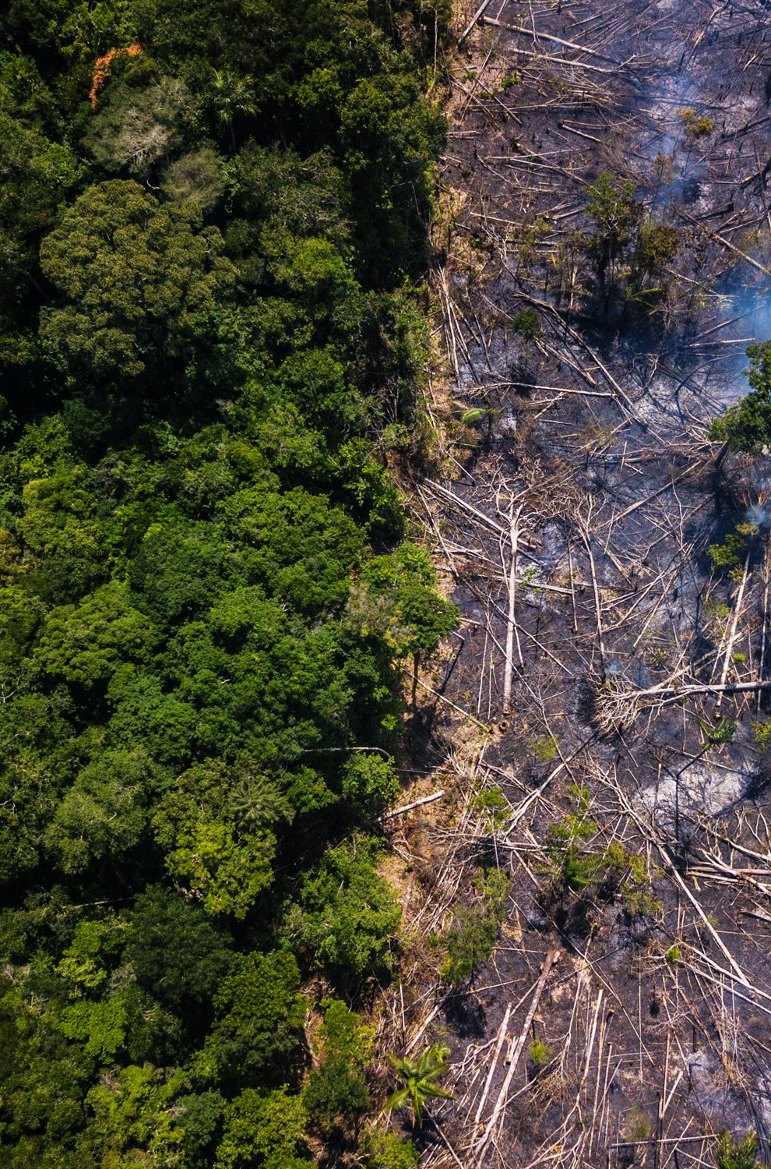
The concept of land cover change
Student Activity: Define Land Cover Change with reference to specific examples. (3 Marks)

Slide 9

The concept of ecosystem structure and dynamics
Ecosystem Structure: The abiotic and biotic features of the ecosystem, their interactions and a source of energy make up the structure of an ecosystem. All of these abiotic and biotic elements are linked together through a series of energy flows and nutrient cycles.
Ecosystem Dynamics: The network of interactions within the ecosystem community, these could include nutrient cycles and energy flows.
Characterised by the complex interactions between the abiotic and biological environments. It involves four major spheres; the biosphere, lithosphere, hydrosphere (and the atmosphere

Slide 10
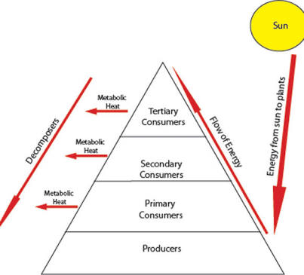
The concept of ecosystem structure and dynamics
Energy Flows – All animals and plants in an ecosystem occupy levels of the trophic pyramid. Food chains/webs pass nutrients and energy flows from one trophic level to the next.
Student Activity: Outline the concept of ecosystem structure and dynamics (3 Marks)
95% of energy lost at each trophic level
Energy is lost through respiration, excretion etc.
Energy is consumed at each level for growth, body heat, energy for movement.
Autotrophs (Producers) have the ability to produce growth undergoing photosynthesis.

Slide 11
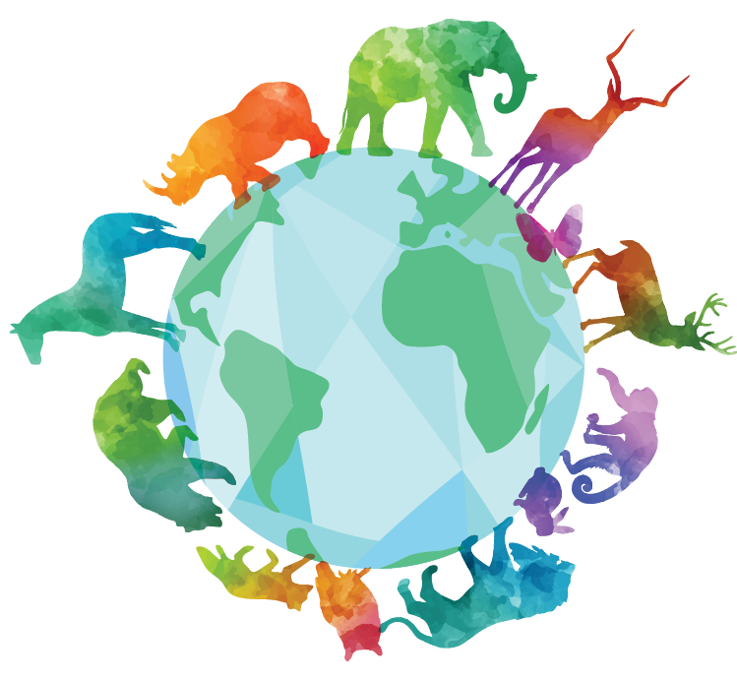
The concept of biodiversity loss
Biodiversity Loss: The reduction in the variety of plant and animal species in the natural environment, as a result of various factors like climate change and land cover change.
It is estimated that the loss of biodiversity has already exceeded the upper limits of rehabilitation, with current extinction rates being 100-1000 times higher than pre-industrial levels.
Interest in Biodiversity has grown rapidly in recent decades with the growing concern about nature conservation, largely as a consequence of accelerating rates of; natural habitat loss, habitat/ecosystem fragmentation and degradation and extinction of species.

Slide 12
The concept of biodiversity loss
Habitat Fragmentation: The process by which habitat loss results in the division of large, continuous habitats into smaller, more isolated remnants.
Student Activity: Define Biodiversity Loss (2 Marks)

Slide 13
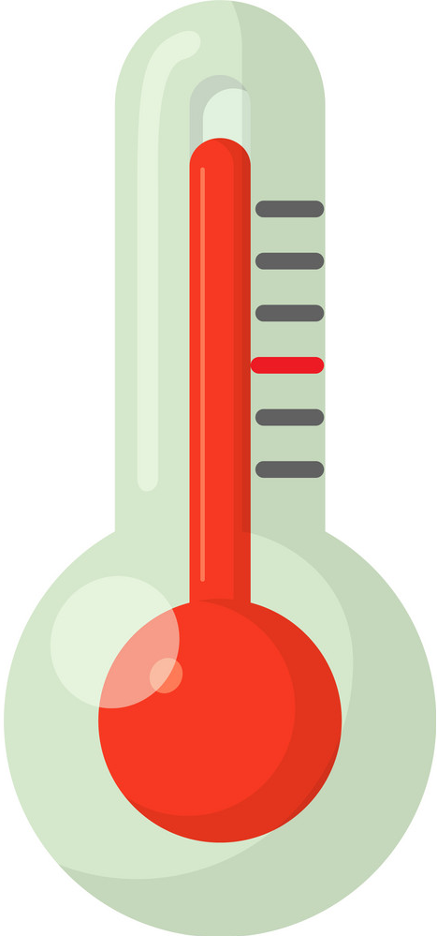
The concept of climate change
Climate Change: Refers to the long-term change in temperatures and precipitation of a region over an extended period of time. This time period can range anywhere from millions of years to decades.
Climate change can occur through both natural and anthropogenic means.
Natural factors include volcanic activity and anthropogenic factors include deforestation and increase of urban settlement.
Refers to a period of global warming (interglacials) and global cooling (i.e ice age).

Slide 14
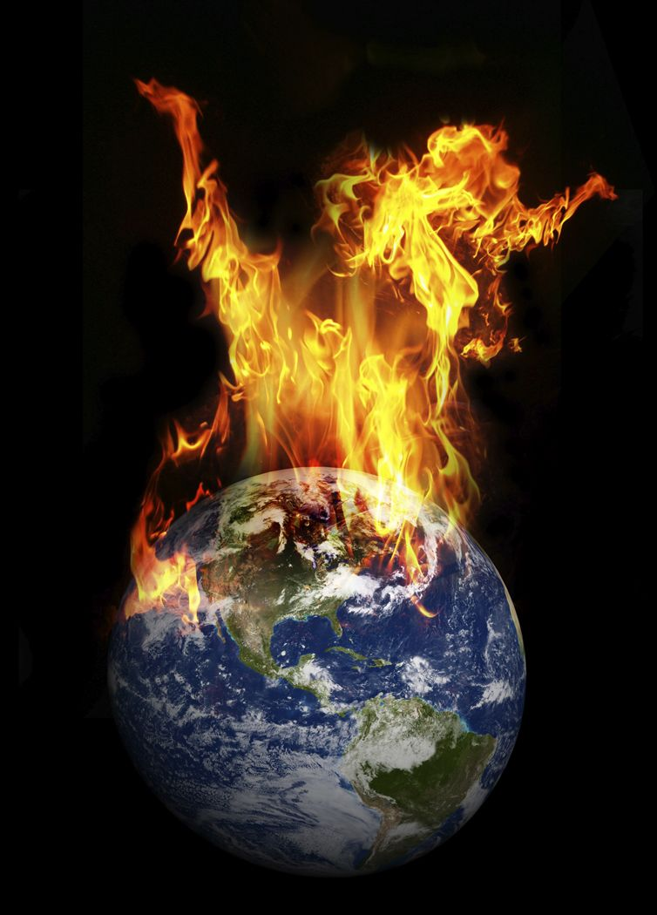
The concept of climate change
Watch: https://www.youtube.com/watch?v=gSt_tDHeg_4
Student Activity: Explain the concept of climate change (3 Marks)
Student Activity: Define Climate Change (2 Marks)

Slide 15
The Concept of Sustainability
Sustainability is the concept of development that considers the impacts on the natural environment, society, economy and future generations.
It involves the protection of the environment while maintaining the economic development necessary to satisfy the needs go the people, while ensuring that the social development of people is not impaired so that they can continue to lead healthy and productive lives.
Student activity: Explain the concept of sustainability (3 Marks)

